Slide 1
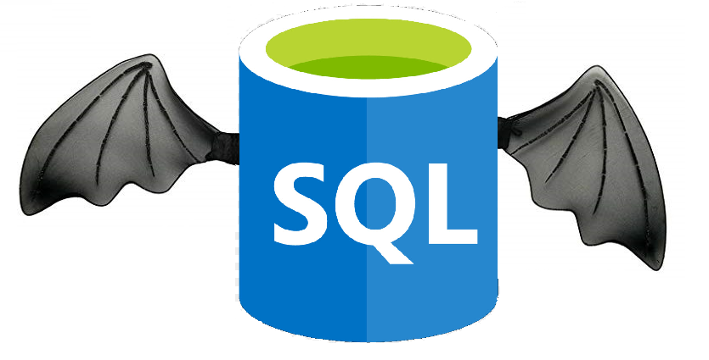
Database on the Fly
Team F5

Slide 2



Our Team
RUSHABH NISHER
ASHU KAPIL
RISHI CHOPRA

Slide 3


KAVITA PATIDAR
SIMARJEET

Slide 4
Agenda
History of Record-Keeping
Record-Keeping Techniques
Our Role
Problem Statement
Assumptions
Proposed Solution
Data Stream
ERD and EERD
UML Diagrams
Conclusion
Milestones

Slide 5
Record Keeping through History
Humans started practice of record keeping about 5000 years ago
Important to keep a track of records as it helps manage costs, improves business and for legal and/ or tax reasons
It provides much needed evidence
Not possible to keep track of everyday business transactions
Notes:
Humans started the practice of record keeping a little over 5000 years ago.
Since then there have been many types of record keeping techniques and methods( viz. Memory, written record keeping, excel, and now MySql)
It provides much needed evidence.
Businesses are growing each day, it is not possible to keep track of daily business transactions
Thus we need a good system for record keeping

Slide 6
Types of record keeping techniques
Before widespread of Computers, most record-keeping occurred on paper
With Computers came File Systems
Then came the era of Excel sheets
Soon, the data outgrew Excel and newer methods were required to contain the ever-growing data
MySQL revolutionized the act of record-keeping
Notes:
- Now that we’ve established that we need to record our daily business transactions, what are the methods for the same?
In the times before writing was invented, records were kept in memory, and we all know how flawed memory can be.
Before the widespread of Computers, most record-keeping occurred on paper
With Computers came File Systems
- Then came the era of Excel sheets and it revolutionized the world.
Soon, the data outgrew Excel and newer methods were required to contain the ever-growing data.
Then came MySQL and it changed how records are kept forever.

Slide 7



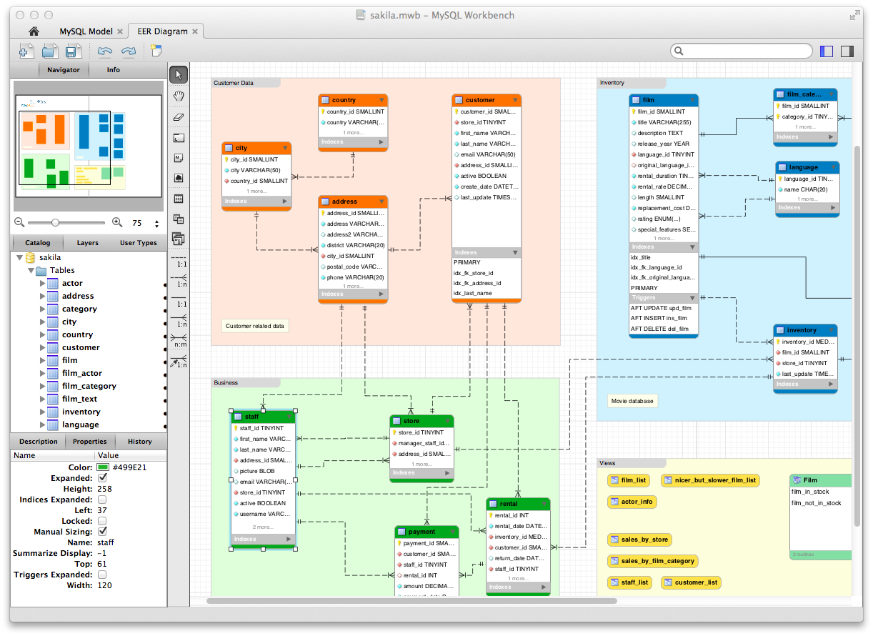

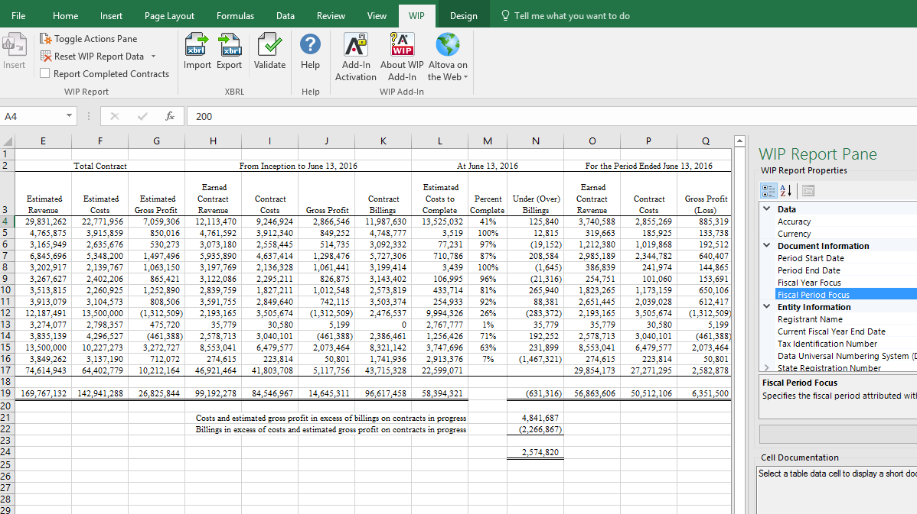
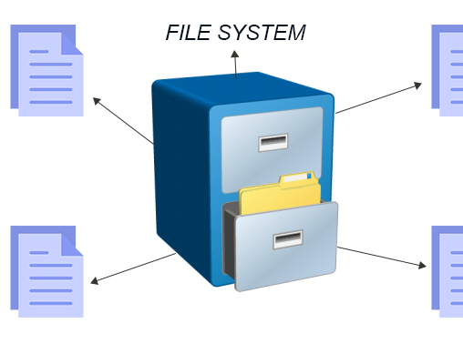


Slide 8
Problem Statement
Generating any database is quite a tedious and costly task
Businesses in similar industry domains tend to have very different type of data management system
Lack of a common type of skeleton
No set methods to convert a data stream to a database
Notes:
Generating any database is quite a tedious and costly task as you all might have experienced doing this project
Businesses in similar industry domains tend to have very different type of data management system
Lack of a common type of skeleton
No set methods to convert a data stream to a database

Slide 9
Our Role
MySQL lacks a sense of automation
We propose a system with which we would be able to generate databases on the fly
All organizations have some or the other level of similarity between them
Notes:
- With MySQL being used widespread for all types of company and businesses, it lacks a sense of automation
We propose a system with which we would be able to generate databases on the fly (As the name suggests)
All organizations have some or the other level of similarity between them
- Wondering what do a Tech company like Dell has in common with a Fashion based industry H&M?

Slide 10
Assumptions
Clients will provide us with the Domain, Sub-Domain and other basic Information, necessary to make the Database
We are not tackling with each and every intricacy of the department structure of each company (i.e. presence of various departments and relationship between them)
We are just showing departments of one company for representational purpose, the process can be replicated easily
Data Stream will contain all the data of the organization
This large file will be a CSV or a JSON file
Functional dependencies of columns not given in the data-stream provided
Notes:
- Potential clients will provide us with the Domain, Sub-Domain and other basic Information, necessary to make the Database
- We are not tackling with each and every intricacy of the department structure of each company
- We are just showing department of two companies for representational purpose, the process can be replicated easily
- Data Stream will contain all the data of the organization, i.e. all the data in one large file (A union of all tables of sort)
- This large file will be a CSV or a JSON file
- We do not have the functional dependencies between the columns of the massive table

Slide 11
Solution
Creating a common database skeleton
Specializing it according to the needs of the client
Making a function to create departments of companies
Trying to tackle with unstructured data
Notes:
Creating a common database skeleton, and specializing it according to the needs of the client. (This would mean that the base structure is the same, but there is some level of difference in the databases of two given companies
Create a function to create departments of the company
Tackle unstructured data

Slide 12
Data Stream to MySQL file
What if we are given a access to the data stream of the Organization?
MySQL supports loading of CSV files to Workbench
This massive table won’t be optimized
Optimization techniques include
Views
Vertical Partitioning
Normalization

Slide 13
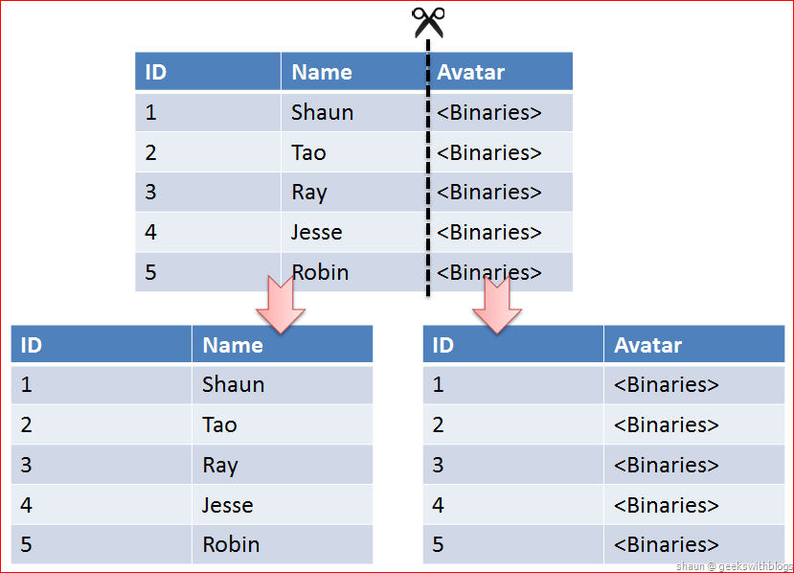
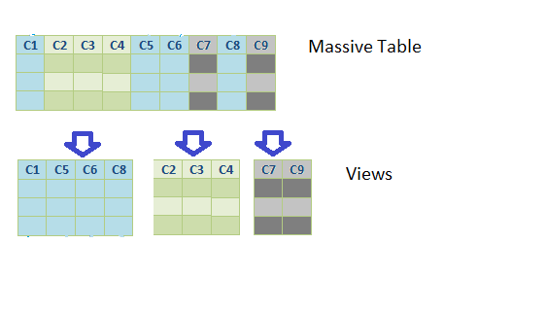
Views
Vertical Partitioning

Slide 14
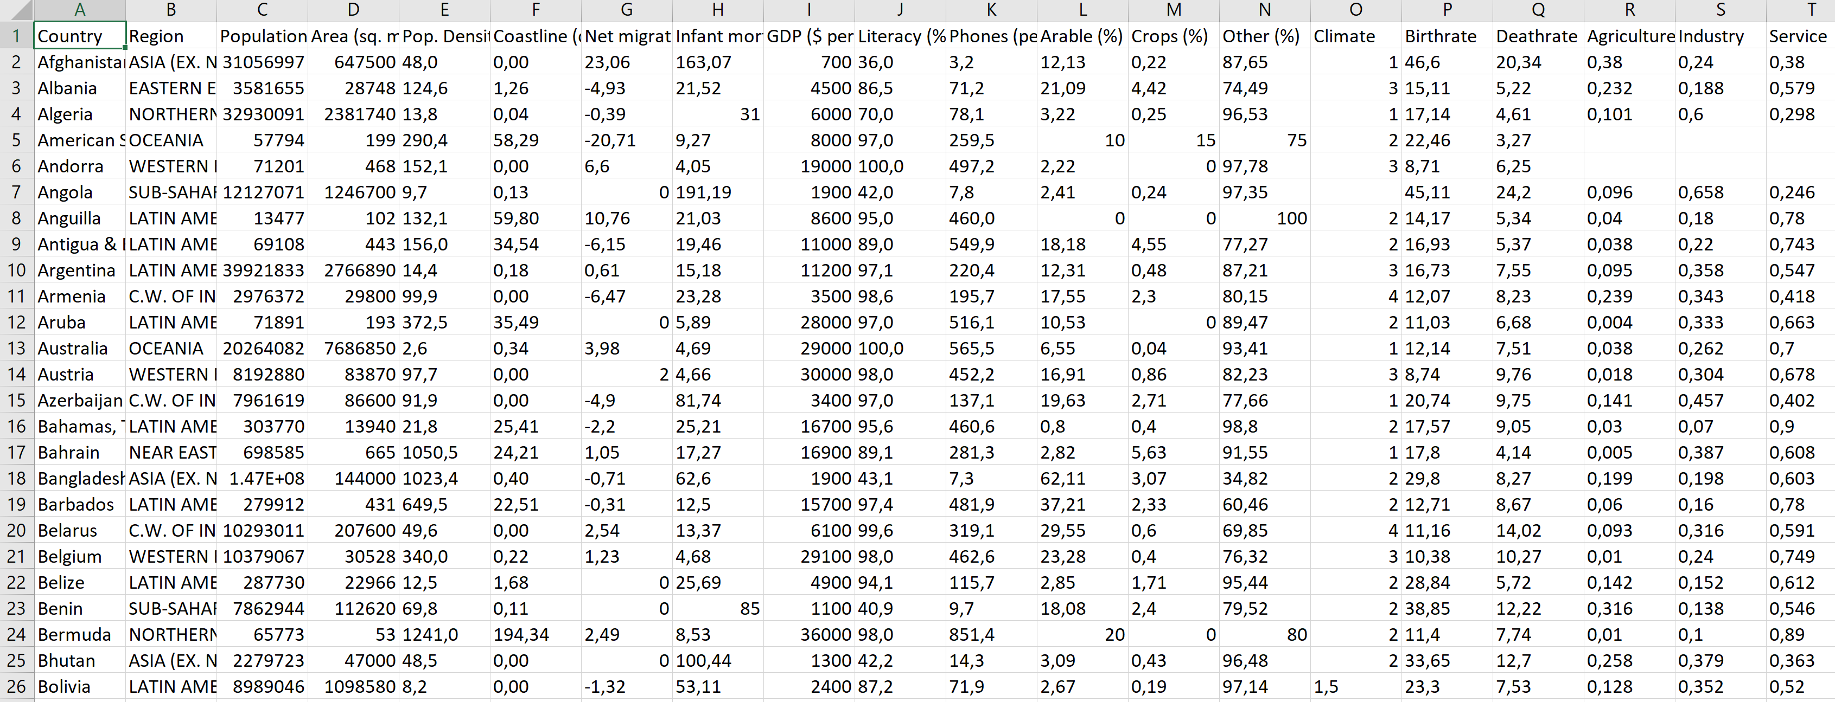
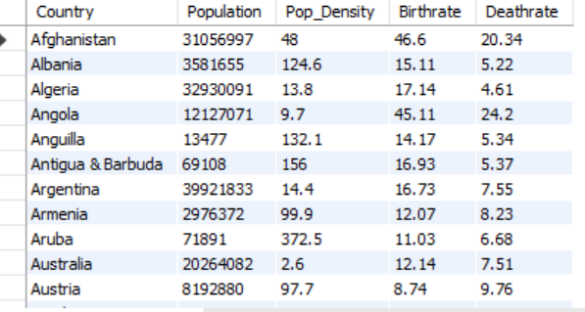
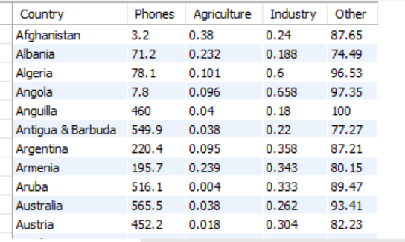
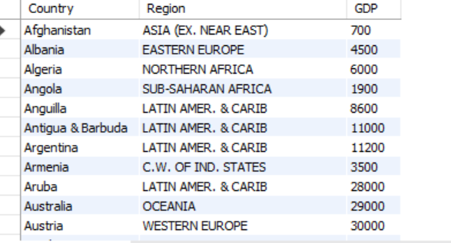
MASSIVE TABLE
VIEWS

Slide 15
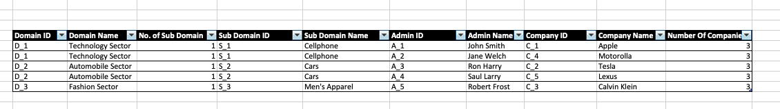

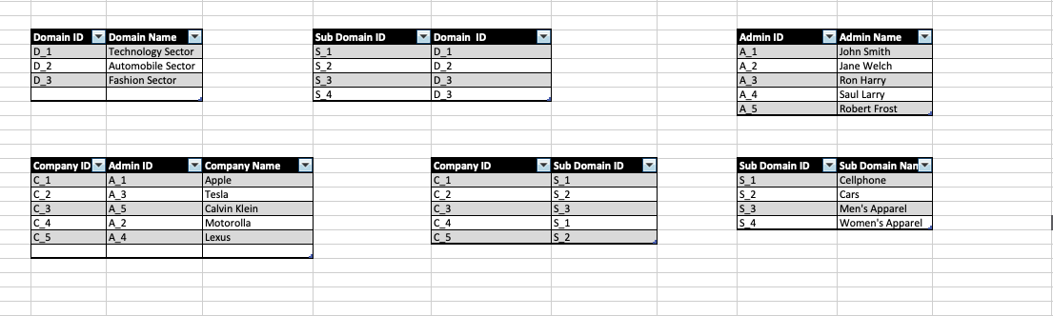
MASSIVE TABLE
NORMALIZED TABLES

Slide 16
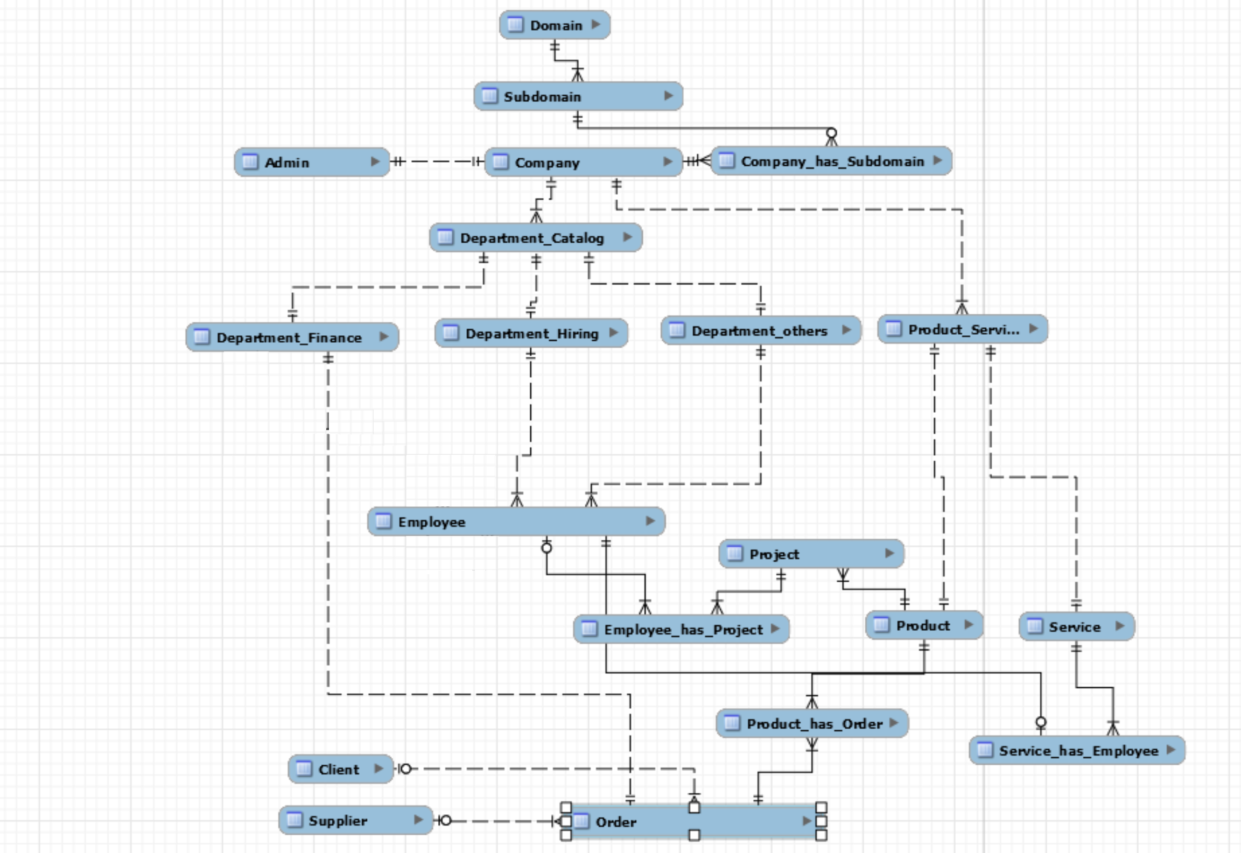
ERD

Slide 17
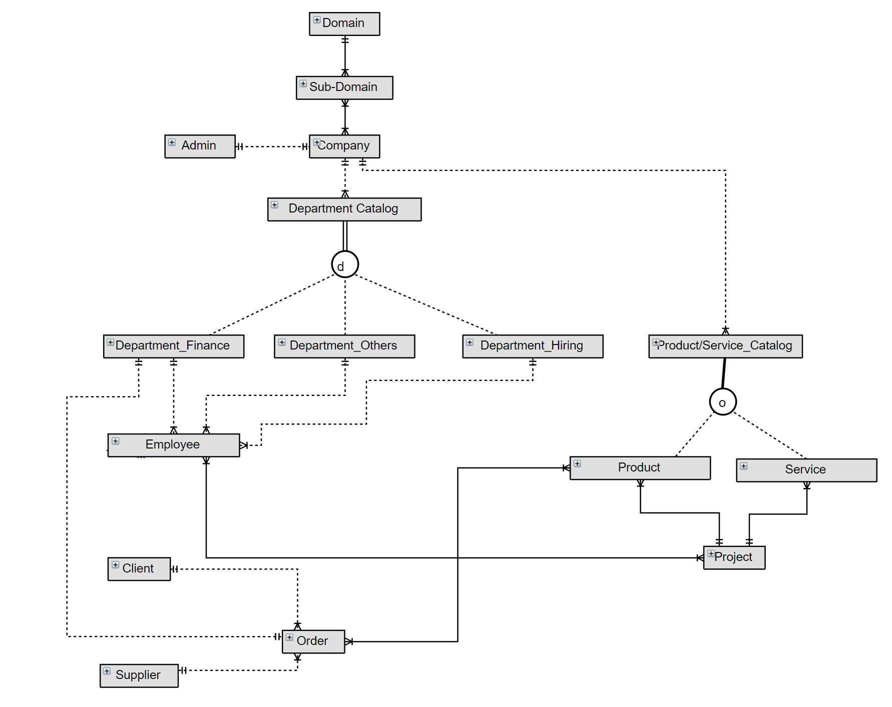
EERD

Slide 18
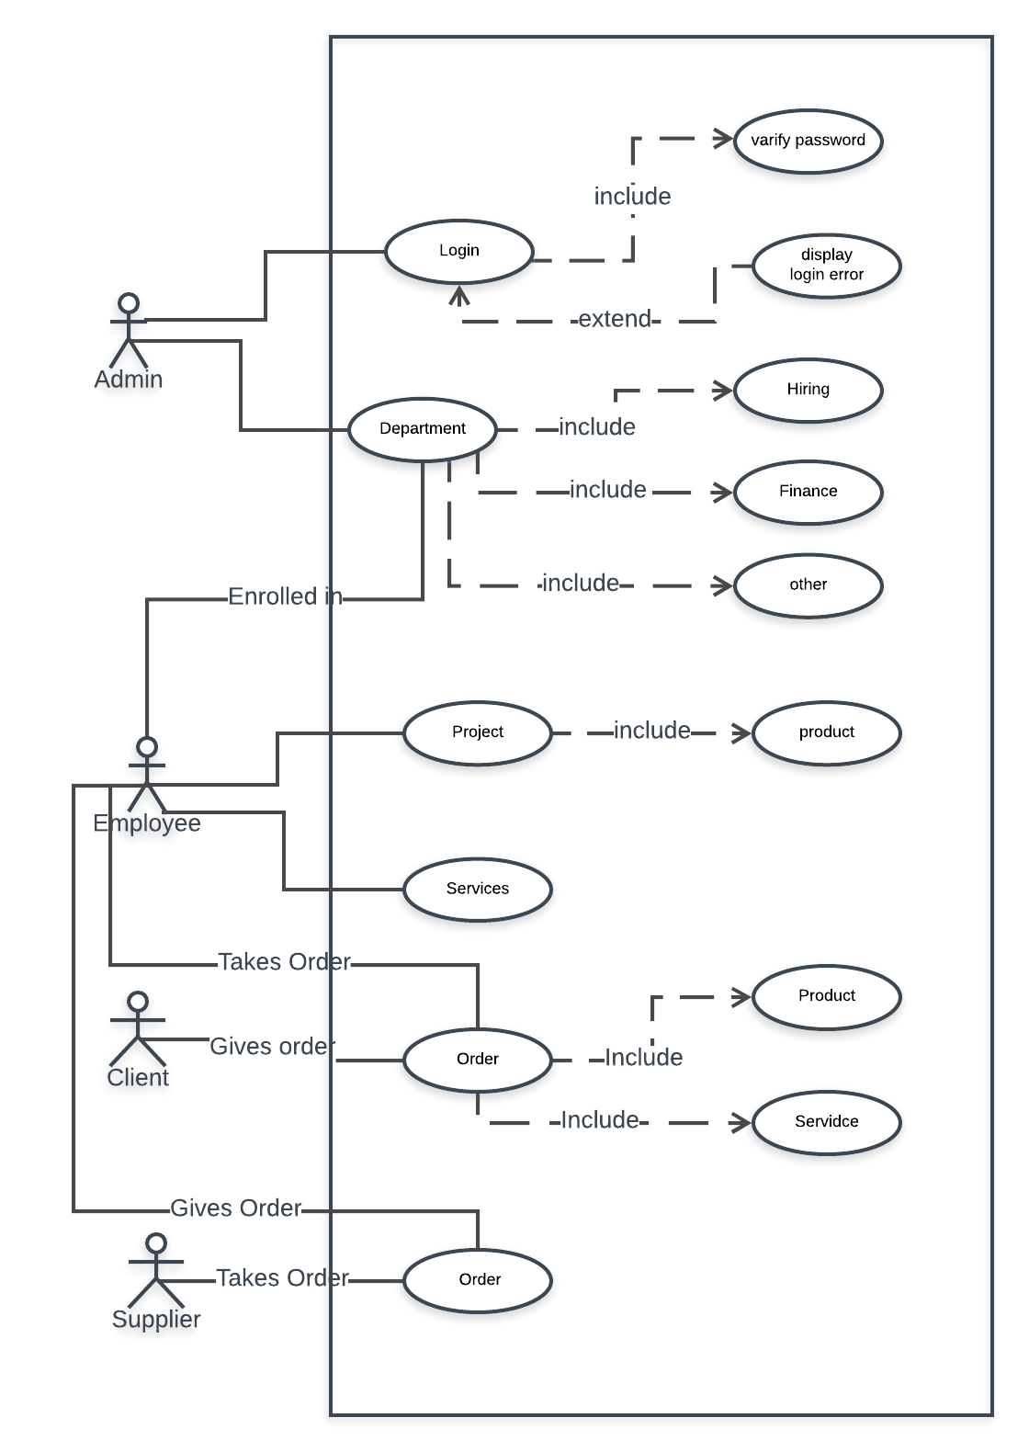
UML –Use Case

Slide 19
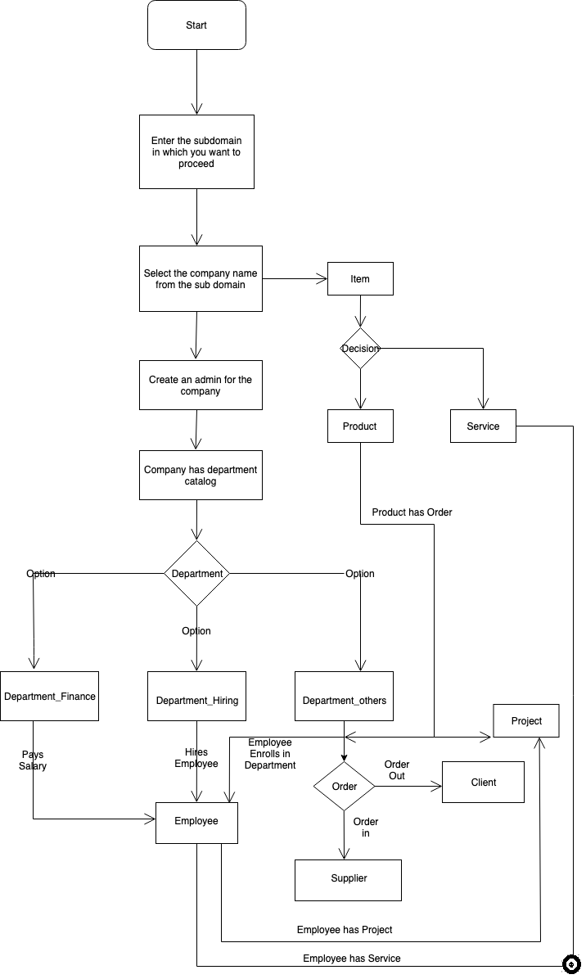
UML - Activity

Slide 20
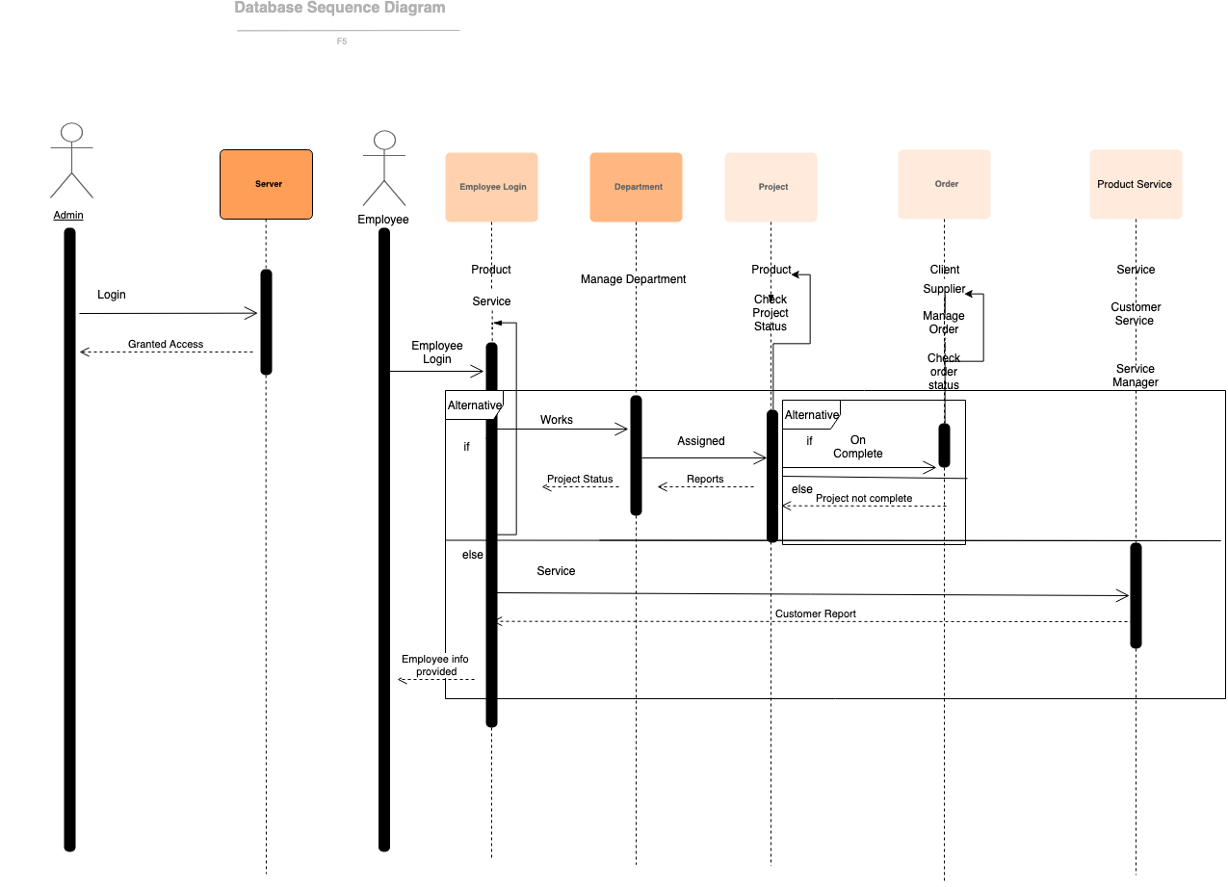
UML - Sequence

Slide 21
Conclusion and Findings
Successful creation of skeleton for generalized database
Use of Procedures to create tables as per the client requirement
Optimized 3 possible solutions for converting a data-stream into a MySQL Database

Slide 22
Key Milestones and Timeline
WEEK 1-3: Team formulation and project proposal.
Week 4-5: Researching about the project and identifying key actors
Week 6-7: Creating ERD diagram, activity diagram and Use cases
Week 8-10: Implementing databases for the system.
Week 11-12: Testing the database system and giving final finishes
Week 13: Submission of the project along with presentation

Slide 23

THANK YOU

